Slide 1

FINAL PROJECT PROPOSAL
Here is where your presentation begins

Slide 2
CONTENTS OF THIS TEMPLATE
Here’s what you’ll find in this Slidesgo template:
A slide structure based on a project proposal presentation, which you can easily adapt to your needs. For more info on how to edit the template, please visit Slidesgo School or read our FAQs.
An assortment of illustrations that are suitable for use in the presentation can be found in the alternative resources slide.
A thanks slide, which you must keep so that proper credits for our design are given.
A resources slide, where you’ll find links to all the elements used in the template.
Instructions for use.
Final slides with:
The fonts and colors used in the template.
A selection of illustrations. You can also customize and animate them as you wish with the online editor. Visit Storyset to find more.
More infographic resources, whose size and color can be edited.
Sets of customizable icons of the following themes: general, business, avatar, creative process, education, help & support, medical, nature, performing arts, SEO & marketing, and teamwork.
You can delete this slide when you’re done editing the presentation.

Slide 3
TABLE OF CONTENTS
01
02
03
ABOUT THE PROJECT
REQUIREMENTS
PROJECT GOALS
04
05
06
SNEAK PEEK
PROJECT STAGES
OUR TEAM
Topic of the section
Topic of the section
Topic of the section
Topic of the section
Topic of the section
Topic of the section

Slide 4
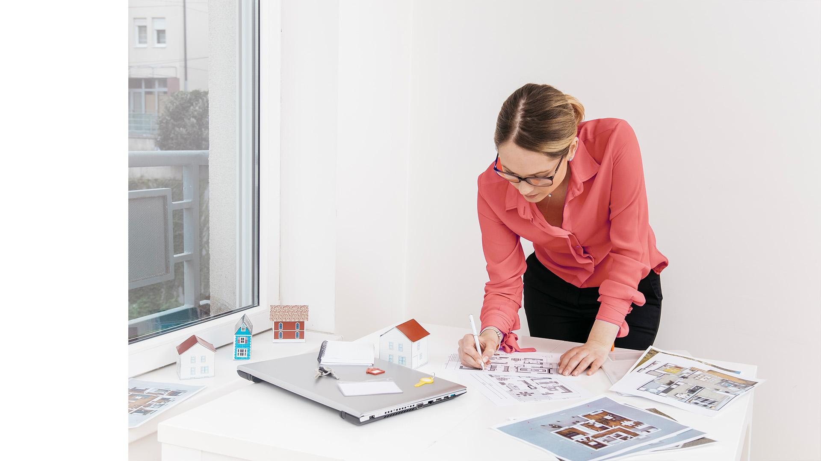
OUR COMPANY
Mercury is the closest planet to the Sun and the smallest one in the Solar System—it’s only a bit larger than the Moon. The name has nothing to do with the liquid metal

Slide 5
WHAT WE ARE WORKING ON
RETAIL
RESIDENTIAL
HOSPITALITY
Despite being red, Mars is actually a cold place
Jupiter is a gas giant and the biggest planet
Saturn is composed of hydrogen and helium

Slide 6

ABOUT THE PROJECT
You can describe the project here
You can describe the project where
You can describe the project here

Slide 7
—SOMEONE FAMOUS
“This is a quote, words full of wisdom that someone important said and can make the reader get inspired.”

Slide 8

THIS IS NOW
Venus has a beautiful name and is the second planet from the Sun. It’s terribly hot, even hotter than Mercury

Slide 9

IN THE FUTURE
Neptune is the farthest planet from the Sun and the fourth-largest one by diameter in the Solar System

Slide 10
MAJOR REQUIREMENTS
MARS
JUPITER
Despite being red, Mars is actually a cold place full of iron oxide dust
It’s a gas giant and the biggest planet in the Solar System

Slide 11
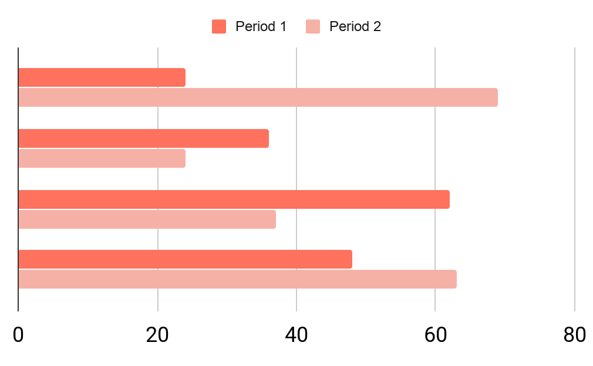
OUR BUDGETS
OBJECTIVES
35%
50%
Games
Media
To modify this graph, click on the link, change the data and paste the new graph here

Slide 12

$8,500,000
This is the total budget

Slide 13
PROJECT GOALS
GOAL 1
GOAL 2
GOAL 3
GOAL 4
Mercury is the closest planet to the Sun
Despite being red, Mars is a cold place
Venus is the second planet from the Sun
Jupiter is the biggest planet of them all

Slide 14

A PICTURE IS WORTH A THOUSAND WORDS

Slide 15
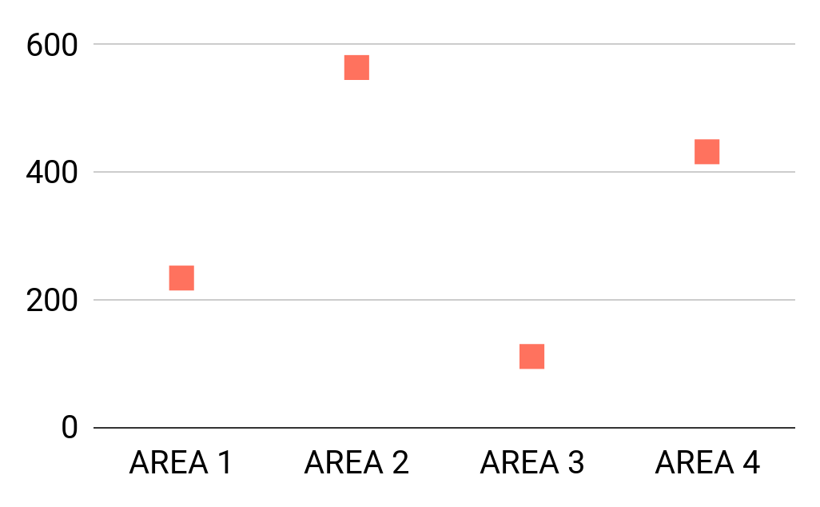
PREDICTED RESULTS
$20,000
88,000
Expected income for 2020
New employees next year
To modify this graph, click on it, follow the link, change the data and paste the new graph here

Slide 16
AROUND THE WORLD
MARS
VENUS
Map about the clients of our company:
Mars is actually a cold place
Venus has a beautiful name

Slide 17

04
SNEAK PEEK
You could enter a subtitle
here if you need it

Slide 18

SNEAK PEEK
You can replace the image on the screen with your own work. Just right-click on the image and choose “Replace image” (Google Slides) or “Change Picture” (PowerPoint)

Slide 19
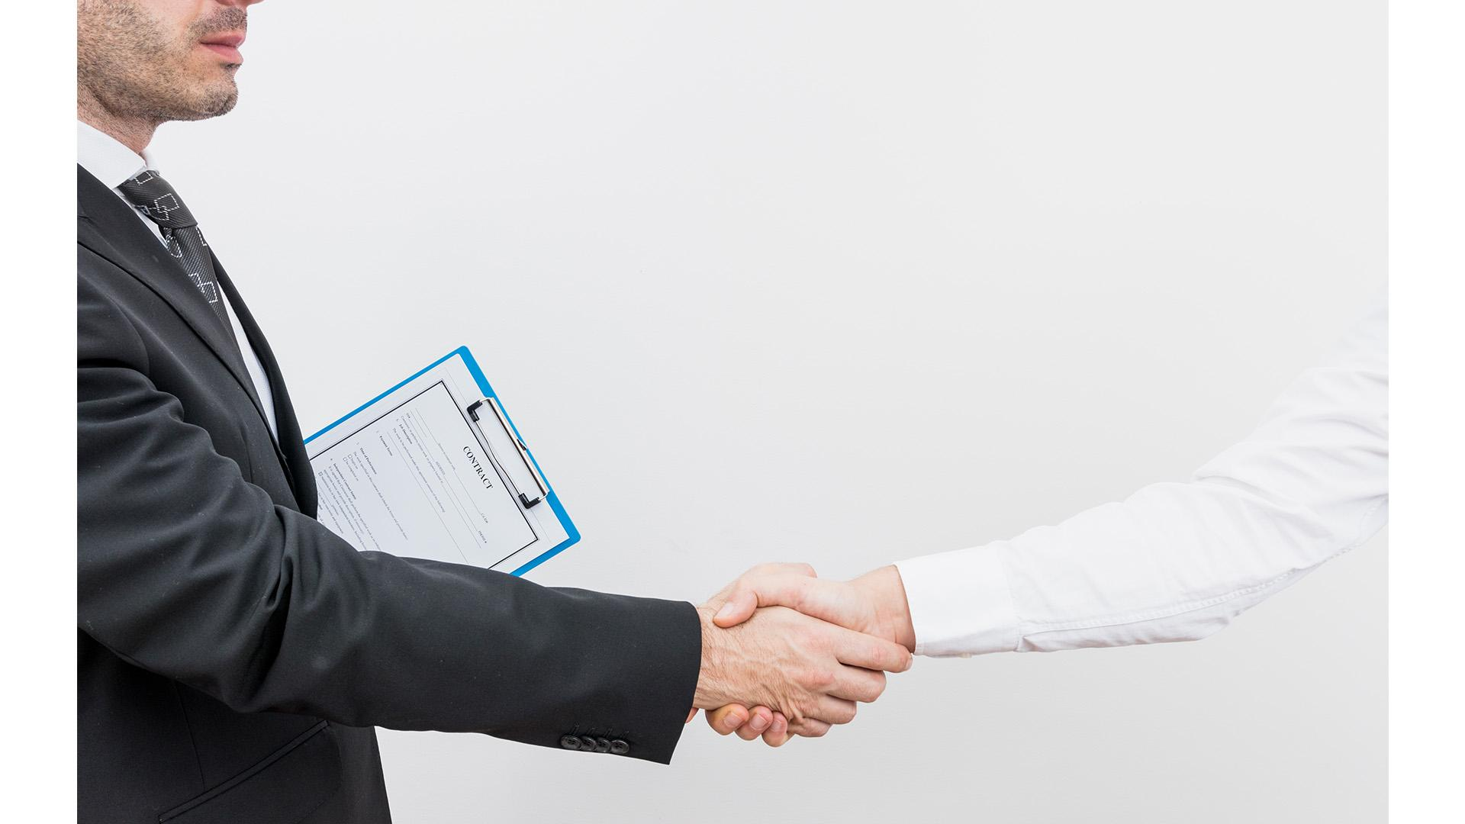
SNEAK PEEK IN STREAMING

Slide 20
PROJECT STAGES
 | STAGE 1 | STAGE 2 | STAGE 3
MERCURY | Mercury is the smallest planet of them all | Ceres is in the main asteroid belt | Neptune is very far away from Earth
MARS | Venus is the second planet from the Sun | Jupiter is the biggest planet of them all | Earth is the planet where we live on
JUPITER | Pluto is an icy dwarf planet | Mars is actually a cold place | Saturn is a gas giant and has several rings

Slide 21

MONTHLY TIMELINE
MARCH
APRIL
MAY
JUNE
JULY
Mars is actually a cold place
Mercury is the smallest planet
Jupiter is the biggest planet
Venus has a beautiful name
Earth is where we live on

Slide 22

OUR TEAM
ROSE DOE
JOHN PATTERSON
ALEXA PRATT
Project Manager
Director of the company
Assistant Manager

Slide 23
OUR PARTNERS
MERCURY
VENUS
MARS
JUPITER
SATURN
NEPTUNE
Mercury is the closest planet to the Sun
Venus is the second planet from the Sun
Despite being red, Mars is actually a cold place
It’s the biggest planet in the Solar System
Saturn is composed of hydrogen and helium
Neptune is the farthest planet from the Sun

Slide 24

THANK
YOU!!!!!
Do you have any questions?
youremail@freepik.com
+91 620 421 838
yourcompany.com
Please keep this slide for attribution

Slide 25

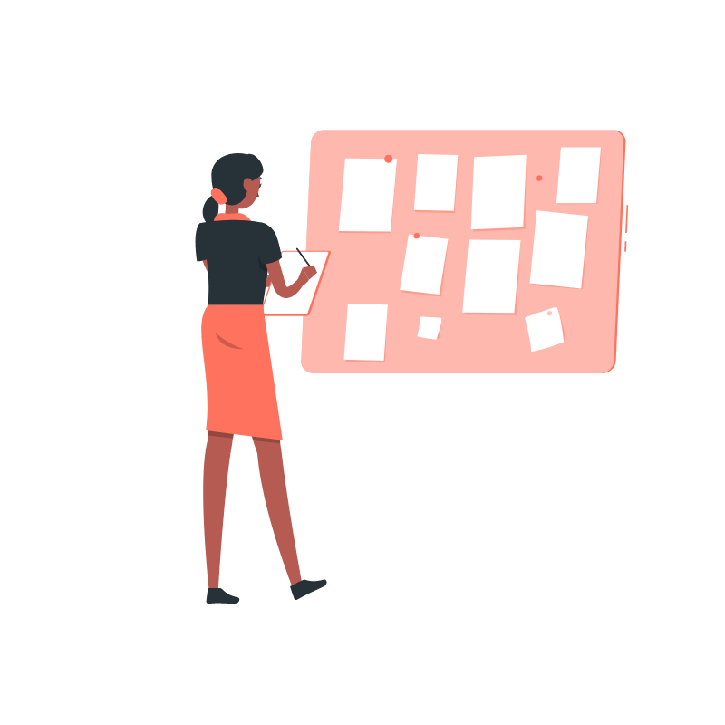





ALTERNATIVE RESOURCES
Find more illustrations like these on Stories by Freepik

Slide 26
PRESENTATION RESOURCES
Did you like the resources on this template? Get them for free on our other websites
VECTORS:
Business deal
Organizing projects
Rising
Market launch
Businessman
Mobile Marketing
Businesswoman
Connected
Startup life
PHOTOS:
Young woman working on blueprint on desk
Smiling woman talking on smartphone with holding white paper at workplace
Smiling attractive female real estate broker sitting in office
Lawyer with client
Find more illustrations like these on Stories by Freepik

Slide 27
Instructions for use
In order to use this template, you must credit Slidesgo by keeping the Thanks slide.
You are allowed to:
- Modify this template.
- Use it for both personal and commercial projects.
You are not allowed to:
- Sublicense, sell or rent any of Slidesgo Content (or a modified version of Slidesgo Content).
- Distribute Slidesgo Content unless it has been expressly authorized by Slidesgo.
- Include Slidesgo Content in an online or offline database or file.
- Offer Slidesgo templates (or modified versions of Slidesgo templates) for download.
- Acquire the copyright of Slidesgo Content.
For more information about editing slides, please read our FAQs or visit Slidesgo School:
https://slidesgo.com/faqs and https://slidesgo.com/slidesgo-school

Slide 28
Fonts & colors used
This presentation has been made using the following fonts:
Sarala Bold
(https://fonts.google.com/specimen/Sarala)
Montserrat
(https://fonts.google.com/specimen/Montserrat)
#ffffffff
#000000ff
#f6b1a7ff
#ff725eff

Slide 29




Storyset
Create your Story with our illustrated concepts. Choose the style you like the most, edit its colors, pick the background and layers you want to show and bring them to life with the animator panel! It will boost your presentation. Check out how it works.
Pana
Amico
Bro
Rafiki

Slide 30
Use our editable graphic resources...
You can easily resize these resources without losing quality. To change the color, just ungroup the resource and click on the object you want to change. Then, click on the paint bucket and select the color you want. Group the resource again when you’re done.

Slide 33
JANUARY
FEBRUARY
MARCH
APRIL
MAY
JUNE
PHASE 1
Task 1
Task 2
PHASE 2
Task 1
Task 2
JANUARY
FEBRUARY
MARCH
APRIL
PHASE 1
Task 1
Task 2

Slide 36
...and our sets of editable icons
You can resize these icons without losing quality.
You can change the stroke and fill color; just select the icon and click on the paint bucket/pen.
In Google Slides, you can also use Flaticon’s extension, allowing you to customize and add even more icons.

Slide 37
Educational Icons
Medical Icons

Slide 38
Business Icons
Teamwork Icons

Slide 39
Help & Support Icons
Avatar Icons

Slide 40
Creative Process Icons
Performing Arts Icons

Slide 41
Nature Icons

Slide 42
SEO & Marketing Icons

Slide 43


